Slide 1
Annual Meeting
January 26, 2019
Wayne Jensen, Chair

Slide 2
*History of Capital Related Votes *History of the Alaska Committee *Alaska Committee Activities *Being the Capital City

Slide 3
History of Capital Related Efforts
Between 1960 and 2006 – 13 votes related to moving the Capital or the Legislature or limiting the length of the Legislative Sessions
1974 Initiative to build a new Capital passed by 57%
2006 Initiative to reduce Legislative Sessions to 90 days passed by 50.1%

Slide 4
History of the Alaska Committee
Formed in 1995 as a nonprofit Corporation following the failed 1994 effort to move the Capital to Wasilla
“Purpose….enhancing Juneau as Alaska’s capital city”
“Nonprofit, nonpartisan, nonsectarian”
“Any Alaskan sharing the purpose of the organization shall be eligible for membership”

Slide 5
Operation of the Alaska Committee
22 member Board of Directors: 17 members elected for 3-year terms and 5 designated positions
Wayne Jensen, Chair Teresa Young
Rosemary Hagevig, Vice Chair Samantha Dye
Win Gruening, Secretary Sen. Dennis Egan
Max Mertz, Treasurer Duff Mitchell
Mary Becker Tim McLeod
Dru Fenster
Ann Metcalfe Beth Weldon, Mayor
Charlie Ellis Robert Venables, SE Conf
Kevin Jardell Liz Perry, Travel Juneau
Diana Cote Brian Holst, JEDC
Jeff Grant Craig Dahl, Juneau Chamber

Slide 6
Operation of the Alaska Committee
Monthly meetings:
7 AM Second Wednesday, JEDC
Annual Meeting: January 26, 9 AM, Alaska Room, JNU
Election of Board Members
Review of the annual budget
Review of past years activities
Plan for future activities
Funding: The Assembly funds the Alaska Committee and Gavel Alaska from the “Better Capital Fund”
Gavel Alaska - $355,000
Alaska Committee - $100,000
Juneau Chamber provides administrative support

Slide 7
Focus of the Alaska Committee
Access to the Capital
Air
Road and Ferry
Electronic
Infrastructure
Transportation
Parking
Capitol Campus
Downtown
Communications
Gavel Alaska
Social Media
Polling
Outreach
Regional Organizations
State-wide Organizations
Partner Opportunities

Slide 8
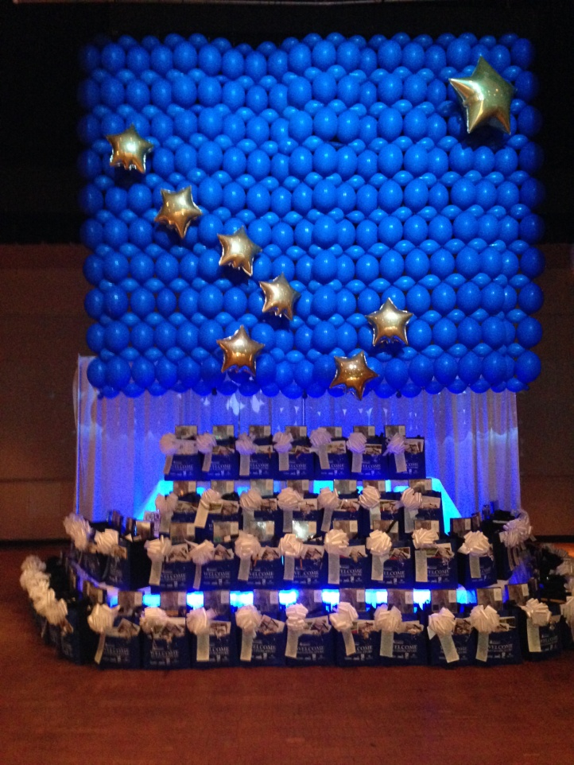
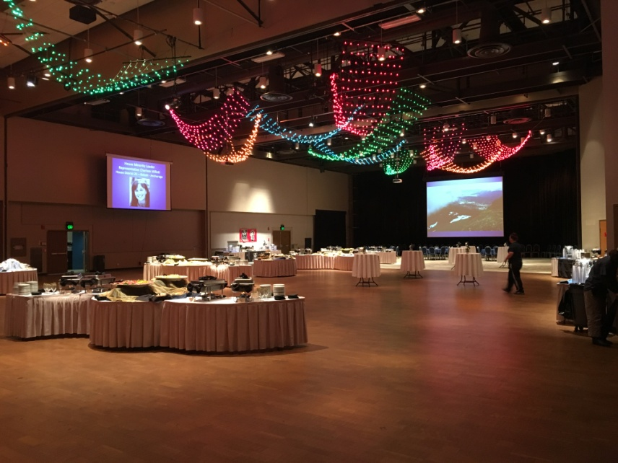
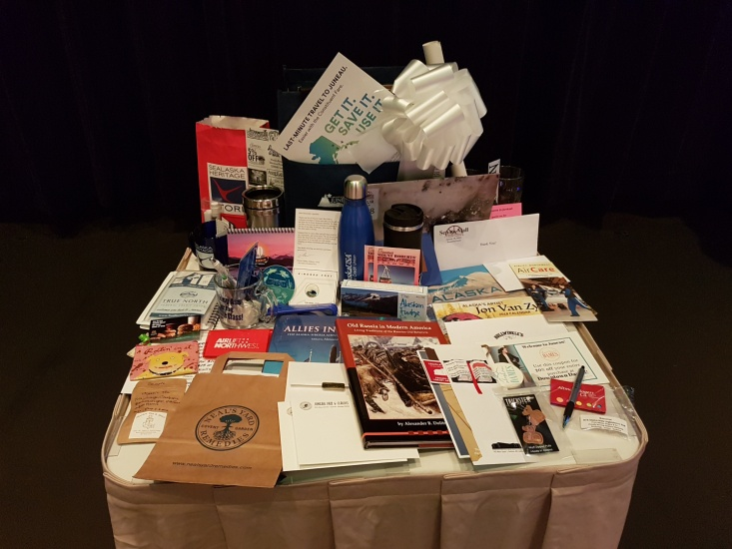
Activities of the Alaska Committee
34th Annual Legislative Welcome Reception
January 16th - Centennial Hall, 5-6:30

Slide 9
Activities of the Alaska Committee
Polling – JEDC Visitor Satisfactions Surveys

Slide 10
Activities of the Alaska Committee
Polling – JEDC Legislative Satisfaction Survey
Legislators and Staff like:
The walkability of downtown
The friendliness of the community
Arts, Entertainment and Recreation
Gavel Alaska
Capitol Complex
Legislators and Staff Concerns:
Parking
Safety of downtown
Cleanliness of downtown
Access from Airport
More evening flights to Anchorage

Slide 11
Activities of the Alaska Committee
Polling – JEDC Visitor Satisfaction Survey
Visitors like:
Walkability of downtown
Friendly Efficient Service
Airport facilities
Juneau Hotels
Visitors Concerns:
Parking
Safety downtown
Cleanliness of downtown
Access from Airport
More evening flights to Anchorage

Slide 12
Activities of the Alaska Committee
Palmer and Tanana Valley State Fairs

Slide 13
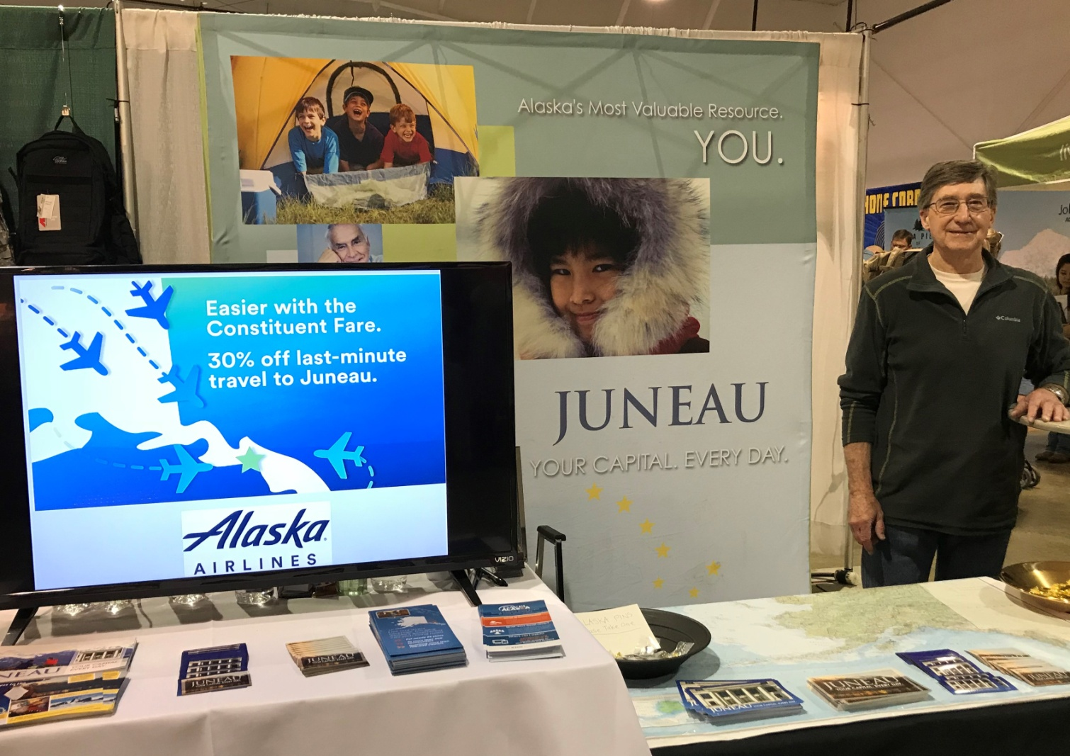
Activities of the Alaska Committee
Alaska Airlines Constituent Fare

Slide 14
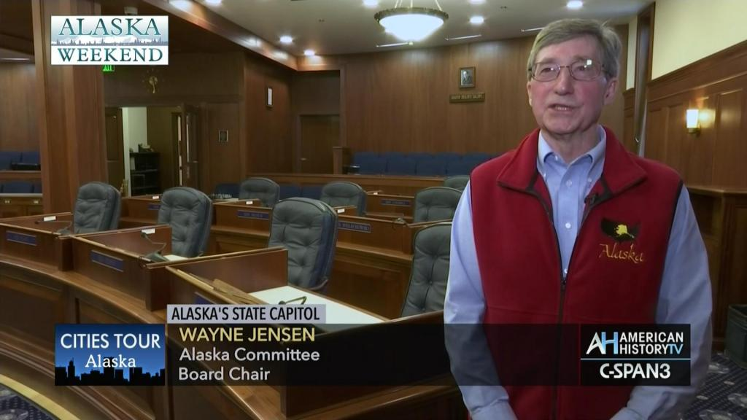
Activities of the Alaska Committee
C-SPAN - 50 Capitols Tour

Slide 15
Activities of the Alaska Committee

Slide 16
Activities of the Alaska Committee
Sponsored events for 100th Anniversary of the Alaska Legislature 2013
Contributed to cost of holding Special Session in Juneau during Renovation
Contributed to cost of Gavel Alaska for Special Sessions
Assist with private funding for Gavel Alaska
Sponsor New Member dinner at AK Chamber Fly-in
Partner with JCC Capitol Fund Advisors on funding for Gavel Alaska capital projects
Send Representatives and sponsor events at SE Conference meetings

Slide 17
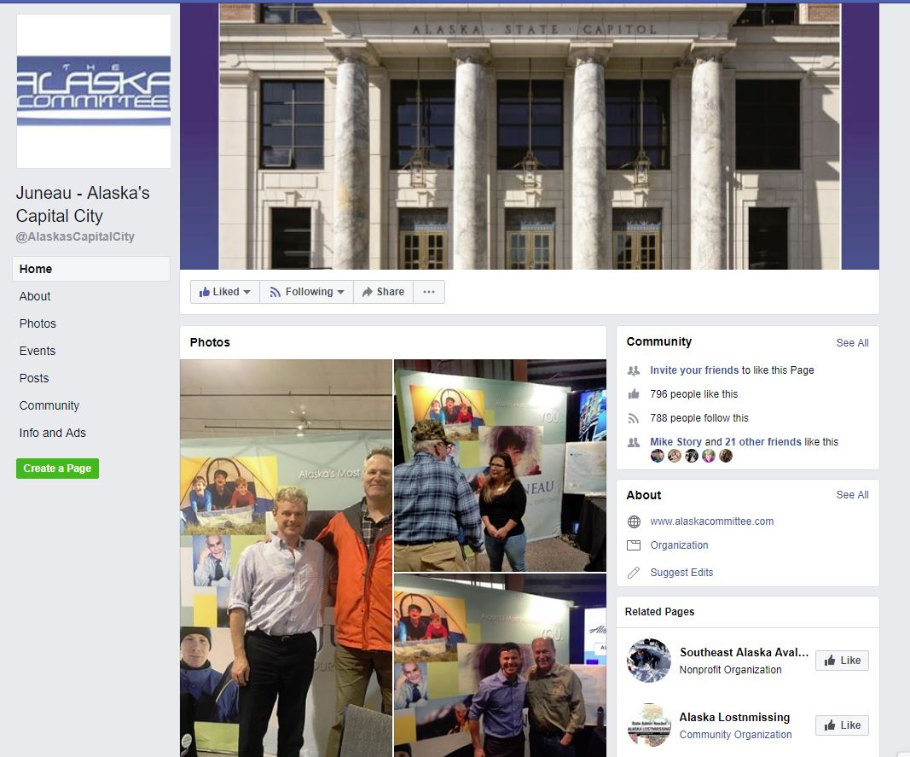
Activities of the Alaska Committee
Facebook: “Juneau – Alaska’s Capital City”

Slide 18
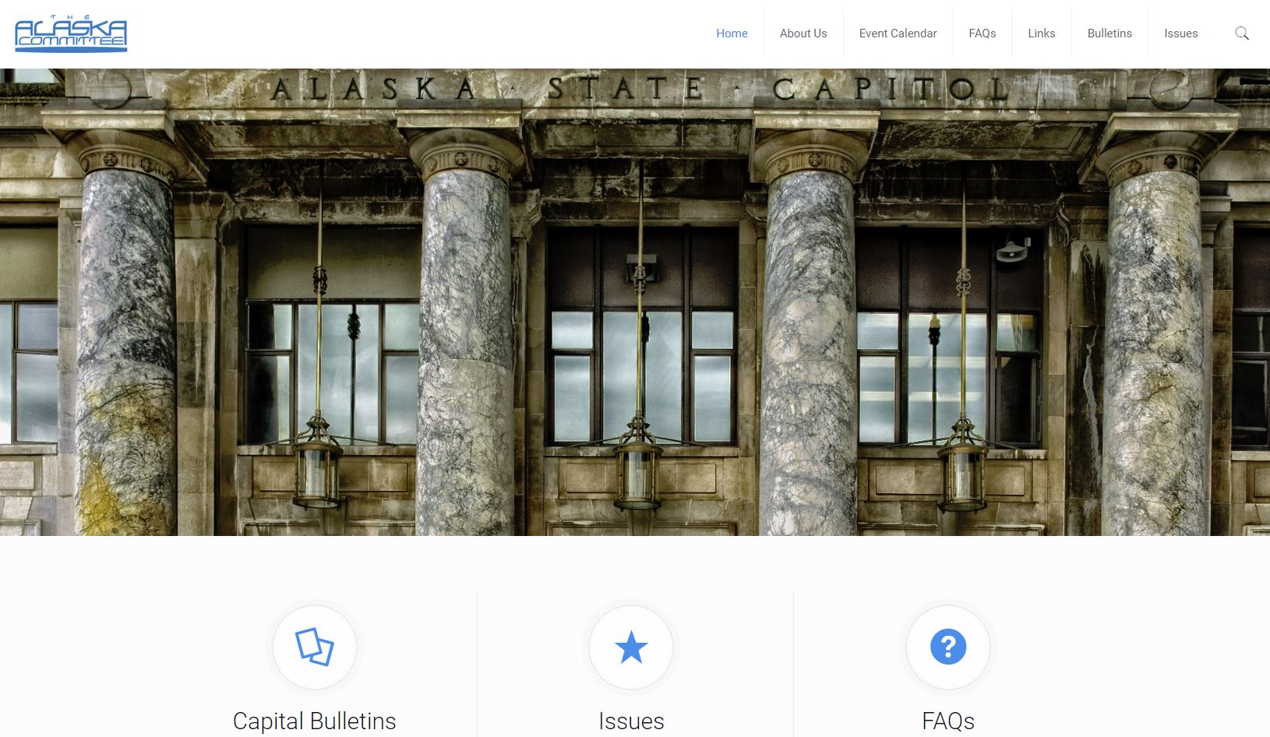
Activities of the Alaska Committee
Website: “Alaskacommittee.com”

Slide 19
Organizations with Shared Interests
CBJ
JEDC
Travel Juneau
Juneau Chamber of Commerce
Southeast Conference
DBA
Develop Juneau
Juneau Community Foundation-Capitol Fund

Slide 20
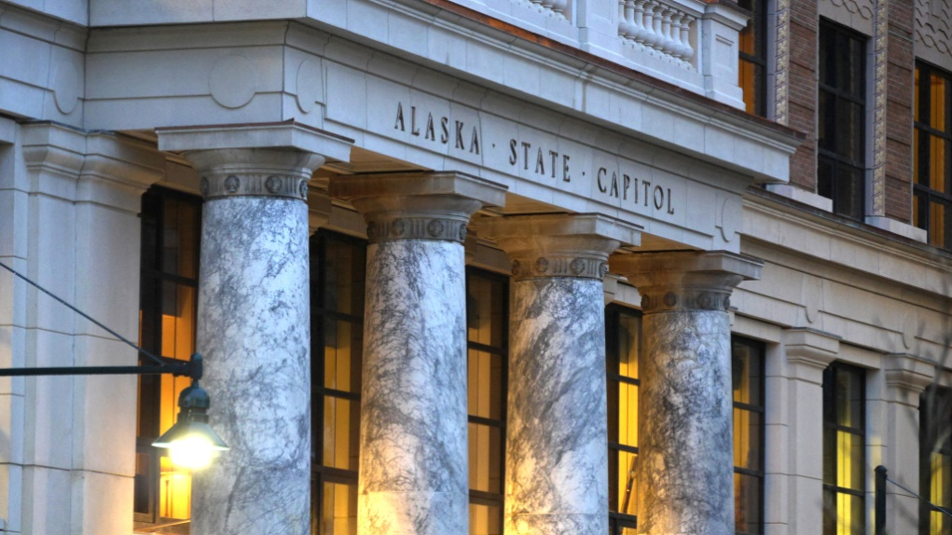
Being the Capital City
Being the Capital City is a privilege and an honor – not a right
We have a responsibility to the rest of the State
We must maintain awareness of the concerns Alaskans across the state have regarding access to their Legislature and their government and continue to inform, educate, reach out and improve if we want to remain the best capital we can be

